Slide 1


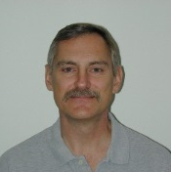
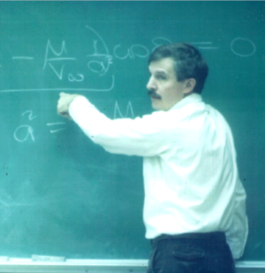
When: 1800, 7 April; TPS Reunion Fly-in
Where: Flight Deck Lounge

